Slide 1
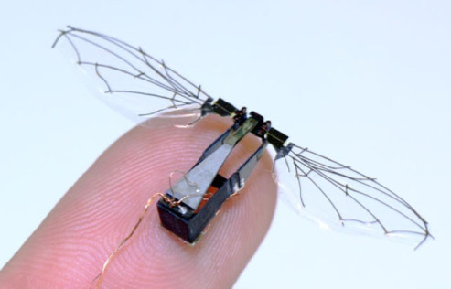
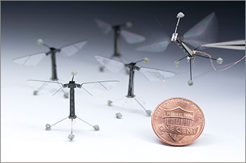
Other Piezoelectric Applications
Harvard Robobee
Meso-scale flying robot
Two piezoelectric components control each wing
Weight less than .1g
Currently wired

